Slide 1
FracBNN: Accurate and FPGA-Efficient Binary Neural Networks with Fractional Activations
FPGA 2021

Slide 2
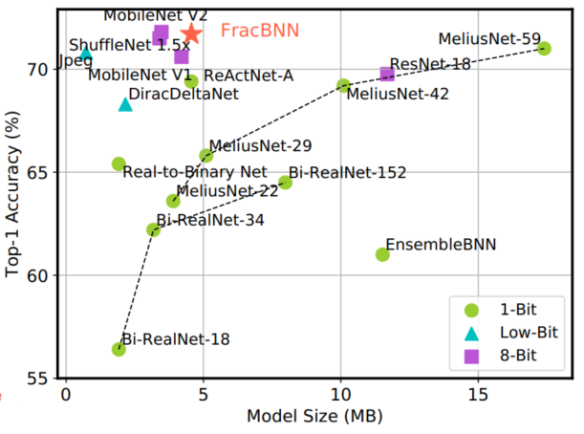
Contributions
Dual-precision activation scheme to compute features with up to two bits, using an additional sparse binary convolution.
Binarize the input layer using a novel thermometer encoding.
Design an efficient FPGA-based accelerator for our novel BNN model that supports the fractional activations.
Preserves all convolutional layers are computed in pure binary MAC operations (BMACs).

Slide 3
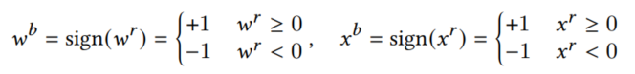
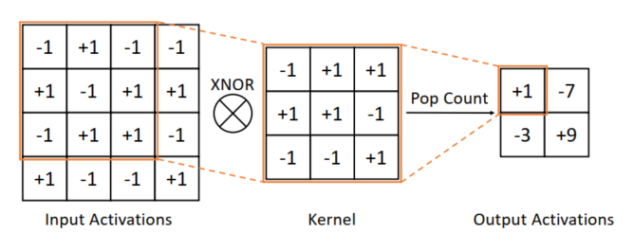
Introduction
With binarized weights and activations, the binary multiply-accumulate (BMAC) operations, which can be implemented in a highly hardware-efficient way using XNORs and population counts (popcnt).

Slide 4
Introduction
FPGAs are a great match for implementing the BNN models, as the BMAC operations can be mapped and executed on the LUT-based logic fabric in a massively parallel fashion.
The reduced memory footprint is also attractive since FPGAs tend to have limited on-chip SRAM capacity.
For these reasons, extensive studies have been devoted to the FPGA acceleration of BNNs

Slide 5
Challenges
BNNs produce a low accuracy on realistic datasets A binarized AlexNet on ImageNet only achieves a top-1 accuracy of 36.1%, which is more than 20% lower (in absolute difference) than the original full-precision model
The first convolutional layer is not binarized Existing BNN models commonly use floating-point weights and activations in the input layer to avoid a large degradation in accuracy
It is difficult to exploit high parallelism to compute the floating-point input layer due to limited DSP resources
not resource-efficient since this engine cannot be reused by other layers

Slide 6
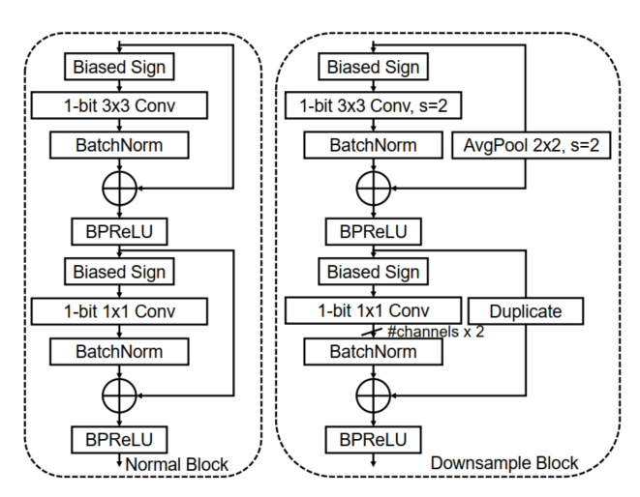
Improved BNN Model
设计了一个类MobileNetV1的网络
取消了depth-wise的操作，全部都是正常卷积
将降采样block的设置为两个block的concat
每一个conv都要Residual-connection
ReActNet building blocks
Zechun Liu, Zhiqiang Shen, Marios Savvides, and Kwang-Ting Cheng. ReActNet: Towards Precise Binary Neural Network with Generalized Activation Functions. European Conf. on Computer Vision (ECCV), 2020

Slide 7
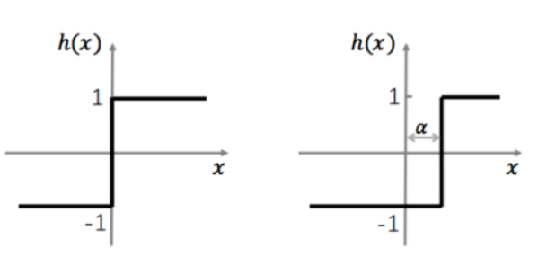
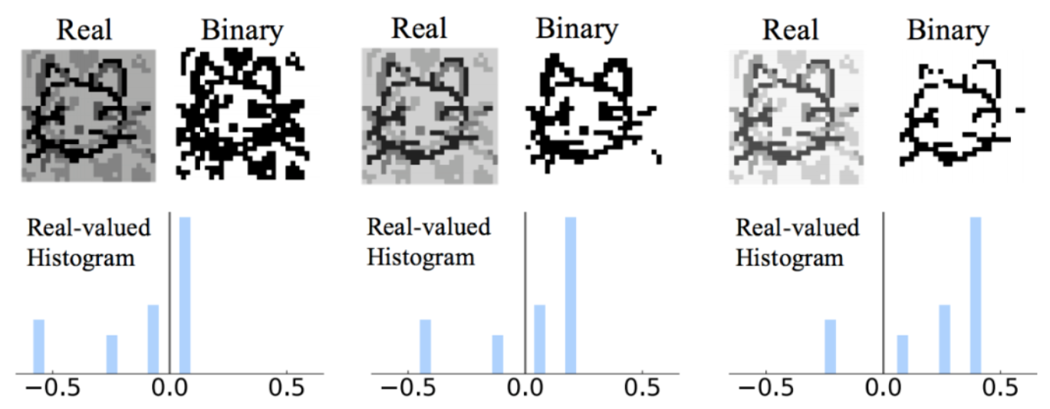
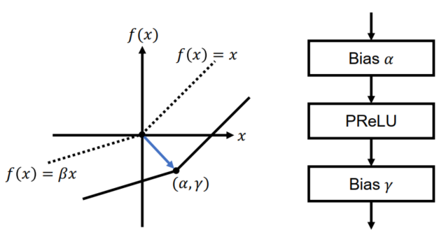

Improved BNN Model
只有在特征图的取值范围合适的时候（中间），所输出的二值化特征图才是包含最多信息量和最容易被网络是别的
通过一个可学习的位移量来让网络自动学习最适合的 binary 阈值和 Activation 的分布
The input layer is still floating-point.
Zechun Liu, Zhiqiang Shen, Marios Savvides, and Kwang-Ting Cheng. ReActNet: Towards Precise Binary Neural Network with Generalized Activation Functions. European Conf. on Computer Vision (ECCV), 2020

Slide 8
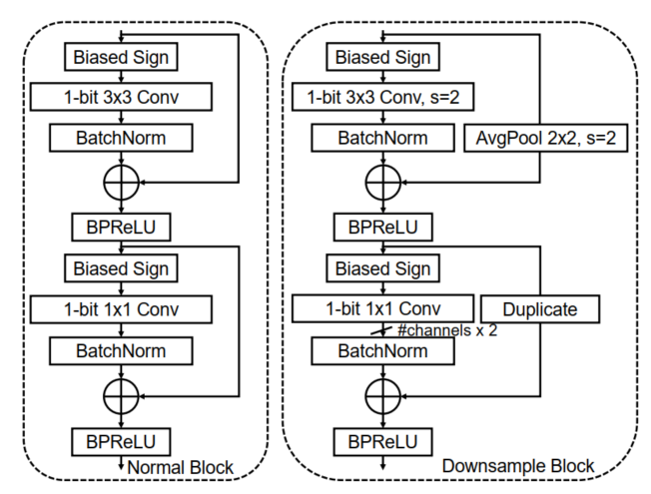
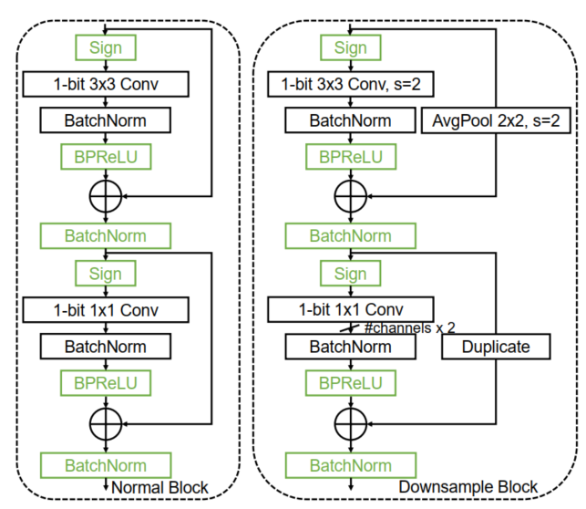
Approach——New Building Blocks
ReActNet building blocks
Given that previous works have pointed out that activation functions residing before the shortcuts tend to perform better
Proposed building blocks
Brais Martinez, Jing Yang, Adrian Bulat, and Georgios Tzimiropoulos. Training binary neural networks with real-to-binary convolutions. Int’l Conf. on Learning Representations (ICLR), 2020.

Slide 9
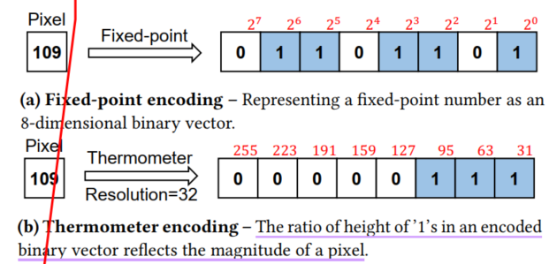
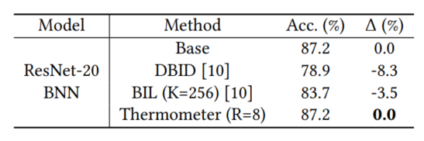
Approach——Binary Input Layer
The challenge of binarizing both weights and activations in the input layer is the lack of input channels.
Three RGB channels are insufficient for binarization. It is therefore necessary to split the images into more channels.
Channels: 3 -> 765 (255*3) 𝐿 = 255, 编码长度
use thermometer encoding to transform a pixel to a thermometer vector.
Robert Dürichen, Thomas Rocznik, Oliver Renz, and Christian Peters. Binary Input Layer: Training of CNN models with binary input data. arXiv preprint arXiv:1812.03410, 2018.
Notes:
DBID直接把input的维度HxWxC变成HxWxCM,M是位宽。就是按bit切分。而BIL就是在切分好input data和原始的第一层卷积之间加入一个 BIL和一个HxWxk对的filters
温度计编码可以 更好的保存特征 在二值化以后的相似度

Slide 10
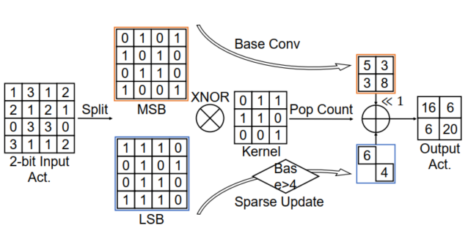
Approach——Fractional Convolution
Dynamically updates important features to high precision to improve the model accuracy.
计算过程和Precision Gating一致，先计算MSBs,然后做一个判断，如果是大于阈值，则mask稀疏计算LSBs，再两者相加
Yichi Zhang, Ritchie Zhao, Weizhe Hua, Nayun Xu, G. Edward Suh, and Zhiru Zhang. Precision Gating: Improving Neural Network Efficiency with Dynamic Dual-Precision Activations. Int’l Conf. on Learning Representations (ICLR), 2020.

Slide 11
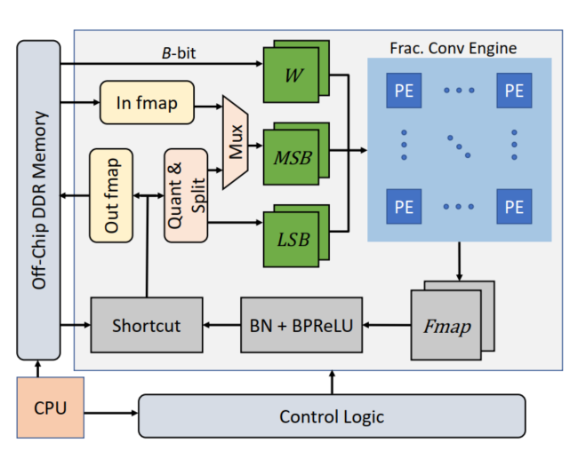
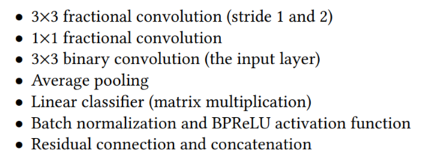
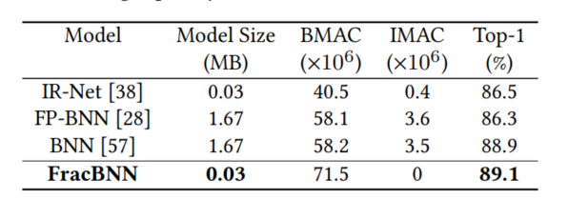
Accelerator Design
Accelerator consists of the following types of operations:
Accelerator architecture
Cifar-10

Slide 12
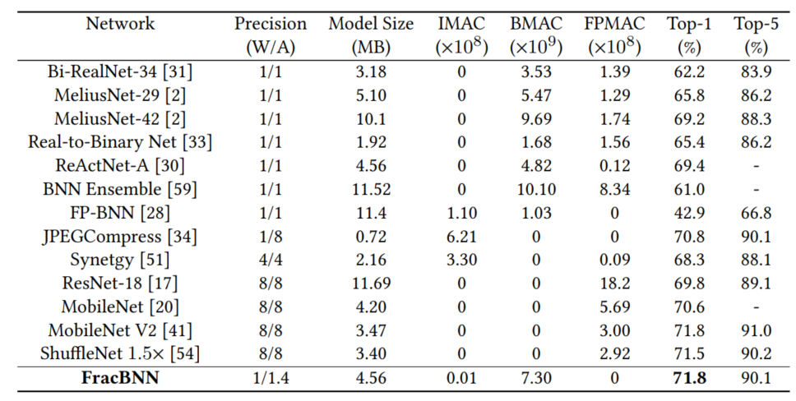
Evaluation
Comparison of FracBNN with other efficient models on ImageNet

Slide 13
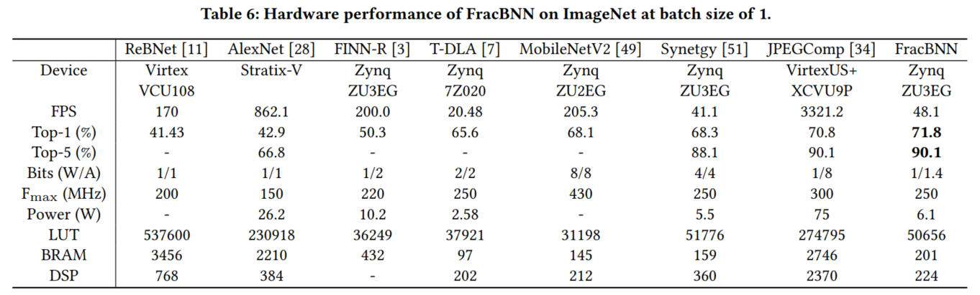
Evaluation
FPGA Implementation

Slide 14
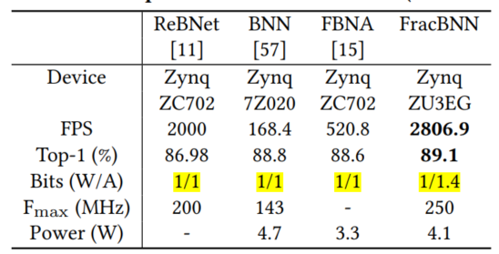
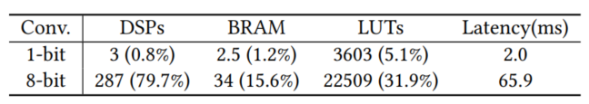
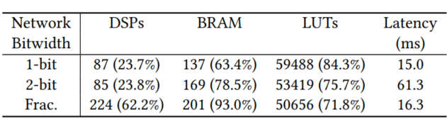
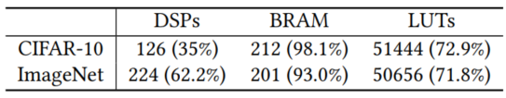
Evaluation
FracBNN performance on CIFAR-10 (batch size 1)
Implementation of FracBNN input layer and an 8-bit conventional input layer.
Implementation of 1-bit, fractional, and 2-bit Networks on ImageNet
Resource utilization of the FracBNN accelerator

